Slide 1
Approval for IISc Teardown Analysis of Benchmarked cells (Phase -3)
Activities
Tear down
Physical Measurements (Benchmark design) – (Priorityy 1)
  Electrodes Length / Thickness / Loading (mg/cm²) / Tab & tape locations…
Electrochemical Measurement (Priority 2)
  Charge/Discharge: To find Reversible capacity & cycling profile
Benchmarking cells (priority wise):
BAK 5.5Ah_ 21700
4680 Gen2 - Tesla
32700 – Blivex _ 6 Ah
CBAK 15 Ah _32140
EVE 5 Ah 21700
SVOLT 116 Ah
Molicell 4.2 Ah
RIN cell -5.8 Ah, after testing
Lab-time required: 15 days (working)
R&D scientists involve: 3 person (minimum)
Tentative Costs: 3,60,000 INR + GST 18% (Updated quotation: 4,42,500 INR – including GST – Approved by CEO)
Tentative Travel costs: 50,000 INR

Slide 2
Cell details for teardown
Sr. No. | Cells to teardown Priority wise | Teardown of benchmarked cells | Electrochemical characterization | Material characterizations @ CENSe, IISc
1 | BAK 5.5Ah_ 21700 | Priority1 | Priority1 | Priority1
2 | 4680 Gen2 - Tesla (Dry cell) | Priority1 | No | Priority1
3 | RIN cell -5.8 Ah (after test) | Priority1 | Priority 1 | Priority 1
4 | EVE 5 Ah 21700 | Priority1 | Priority 1 | Priority 1
5 | SVOLT 116 Ah | Priority1 | Priority 2 | Priority1
6 | Molicell 4.2 Ah | Priority1 | Priority 2 | Priority 2
7 | Samsung 4.0 Ah | Priority 1 | Priority 3 | Priority 3
8 | 32700 – Blivex _ 6 Ah | Priority1 | Priority 3 | Priority 3
9 | CBAK 15 Ah _32140 | Priority1 | Priority 3 | Priority 3

Slide 3
Material characterizations
Item |  | Analysis Method | Result
Cathode | Dimension | Vernier Callipers, CP/SEM
 | Morphology | CP, SEM-EDS | Particle, Electrode, Distribution,Ni:Co:Mn:Al
 | Crystal structure | XRD | NCM structure
 | Components | TGA- DSC | Binder content, (binder type)
Anode | Dimension | Vernier Calipers, CP/SEM
 | Morphology | CP, SEM-EDS | Particle, Silicon, electrode, Distribution,Si content
 | Crystal structure | XRD | Graphite structure
 |  | Raman | G D Band
 | Components | TGA-DSC | Binder content, (binder type)
Separator | Morphology | CP, SEM-EDS | Layer
 | Components | TGA-DSC, FT-IR | coating type
Electrolyte | Components | GC-MS, ICP | solvent
Note: Structural & other parts not included here to be evaluated at EESL, Bangalore

Slide 4
Tear-downed sample testing & estimated cost*
 | Samples type | No of samples/ cell | Total sample (9 cells) | CeNSE, IISc | Presidency University
Powder XRD | Cathode, Anode | 2 | 18 | ✓ | ✓
SEM-EDS | Cathode, Anode, Separator | 7 | 63 | ✓ | ✓
NMR | Electrolyte | 1 | 1 (prismatic cell) |  | ✓
Raman | Anode | 1 | 9 | ✓
FTIR | Separator | 2 | 18 | ✓
Anode: 2 SEM samples (Surface and cross section)
Cathode: 2 SEM samples (Surface and cross section)
Separator: 3 SEM sample (Both surface + Cross section)
Estimation of CeNSE Cost*
 | Per hr rate | # sample / cell | # sample total | sample/ hr | Time slot reqd. (hr) | Approximation (hr) | Tentative Cost
SEM-EDS | 2800 | 7 | 63 | 4 | 16 | 20 | 56000
XRD | 2128 | 2 | 18 | 1 | 16 | 20 | 42560
TGA-DSC | To be updated
Raman | 2464 | 1 | 9 | 4 | 2 | 4 | 9856
FTIR | 1456 | 2 | 18 | 6 | 3 | 4 | 5824
 |  |  |  |  | Total Tentative cost |  | 114240
TGA- DSC facility details yet to receive from CeNSE , IISc
* based on previous PO, Need updated quotation for exact numbers

Slide 5
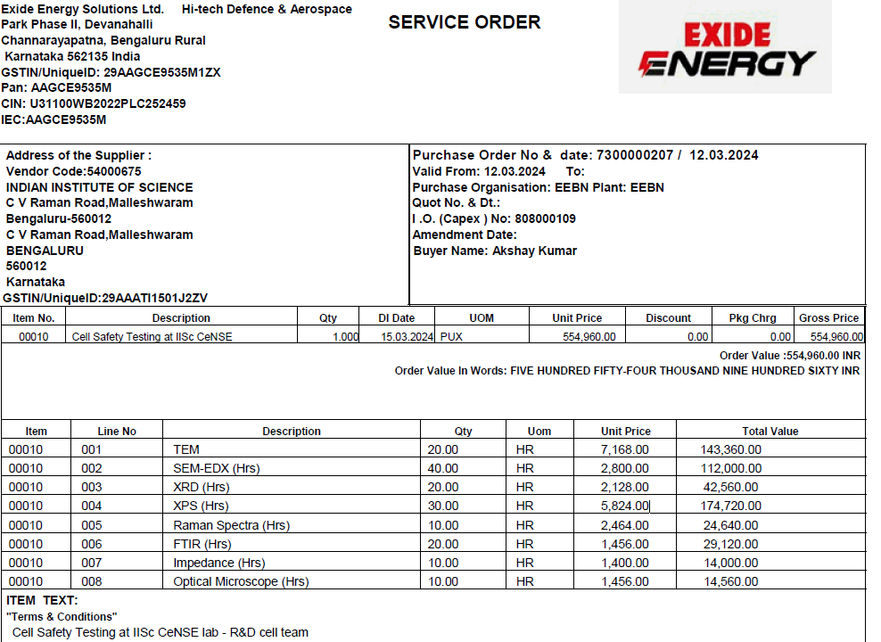
Material characterization plan
List of available facilities
Facilities @ CENSe, IISc
Facilities @ Presidency University, Kolkata (Restricted)
Available instruments accessible to EESL
1. Single Crystal XRD | 4. FT-IR | 7. Fluorescence Spectrophotometer | 10. Electrochemical test station (Autolab)
2. Powder XRD | 5. NMR | 8. TGA | 11. Environmental chamber
3. FE-SEM + EDX | 6. UV-VIS Spectroscopy | 9. Furnace (Tube and Muffle) | 12. Custom made solar charging module

Slide 6
Budget
Sr. No. | Task | Usage time | Budget (INR)
1 | Teardown+ Electrochemical of benchmarked cells | 15 days | 4,42,500 (Approved)
2 | Teardown+ Electrochemical of benchmarked cells | 15 days | 4,42,500 (Need Approval)
3 | Material characterizations @ CENSe, IISc | Slot basis | 2,00,000 (Need approval)

Slide 7
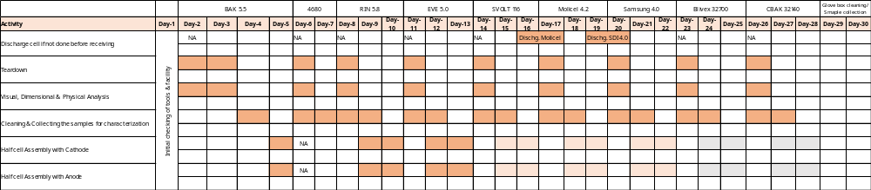
Teardown activity plan_ Gantt Chart
Priority 1
Priority 2
Priority 3

